Slide 1
Customer Shopping Behavior Analysis
Uncovering spending patterns, customer segments, and product preferences from 3,900 transactions to guide strategic business decisions.
DATA ANALYTICS PROJECT
PYTHON · SQL · POWER BI

Slide 2
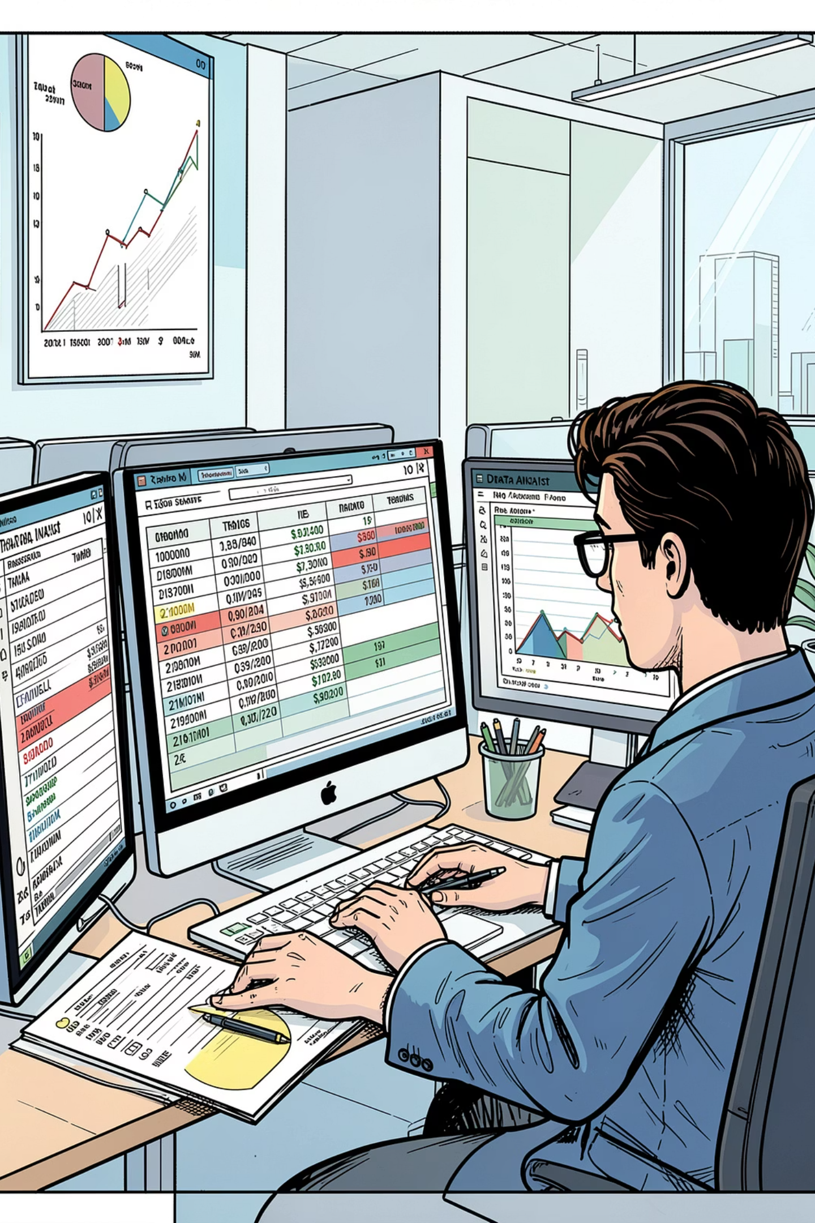
Project Overview
This project analyzes customer shopping behavior using transactional data to uncover insights into spending patterns, customer segments, product preferences, and subscription behavior.
Dataset Size
Key Features
3,900 purchases across various product categories
18 columns covering demographics, purchase details, and shopping behavior
Goal
Guide strategic business decisions through data-driven insights

Slide 3
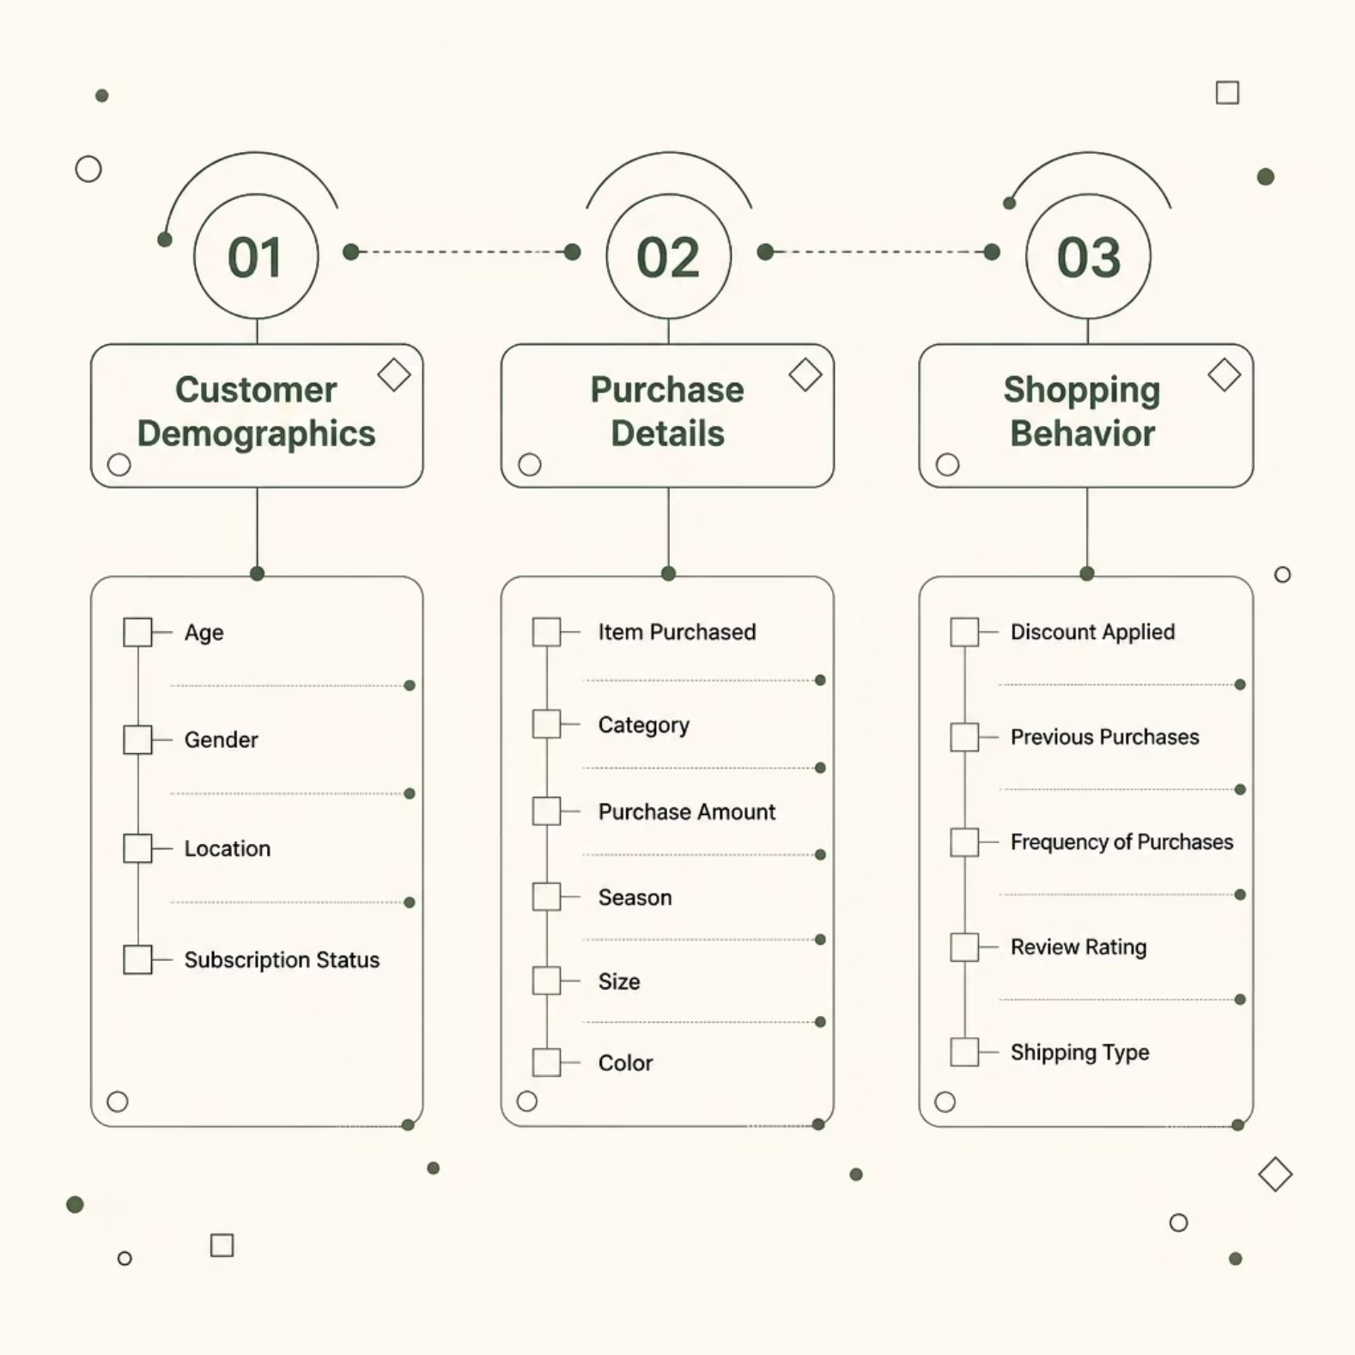
Dataset at a Glance
Dataset Structure
3,900 rows — transactional purchase records
18 columns — demographic, purchase, and behavior features
37 missing values — in Review Rating column only
Key features span
customer demographics (Age, Gender, Location, Subscription Status)
purchase details (Item Purchased, Category, Purchase Amount, Season, Size, Color)
shopping behavior (Discount Applied, Previous Purchases, Frequency of Purchases, Review Rating, Shipping Type).

Slide 4
Data Preparation in Python
Data Loading & Exploration
Missing Data Handling
Column Standardization
Checked null values; imputed missing Review Ratings using the median rating per product category.
Renamed all columns to snake_case for consistency and readability.
Imported dataset via pandas; used df.info() and df.describe() for structure and summary statistics.
Feature Engineering
Database Integration
Created age_group by binning customer ages; derived purchase_frequency_days from purchase data. Verified discount_applied and promo_code_used were redundant — dropped promo_code_used.
Connected Python script to MySQL and loaded the cleaned DataFrame into the database for SQL analysis.

Slide 5
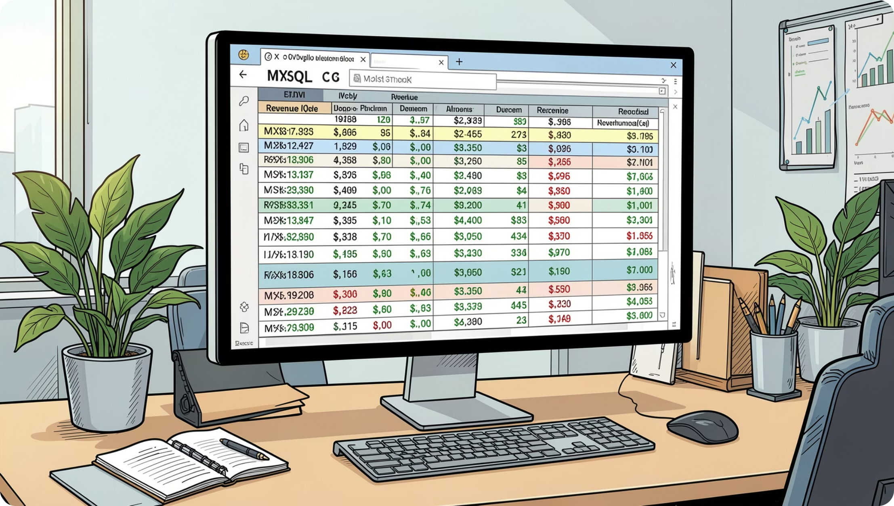
SQL ANALYSIS
Revenue & Customer Insights
Key Analyses
Revenue by Gender — Compared total revenue generated by male vs. female customers
High-Spending Discount Users — Identified customers who used discounts but still spent above the average purchase amount
Top 5 Products by Rating — Found products with the highest average review ratings
Shipping Type Comparison — Compared average purchase amounts between Standard and Express shipping
Subscribers vs. Non-Subscribers — Compared average spend and total revenue across subscription status

Slide 6





SQL ANALYSIS
Segmentation & Product Behavior
Discount-Dependent Products
Customer Segmentation
Top 3 Products per Category
Identified 5 products with the highest percentage of discounted purchases.
Classified customers into New, Returning, and Loyal segments based on purchase history.
Listed the most purchased products within each category.
Repeat Buyers & Subscriptions
Revenue by Age Group
Checked whether customers with >5 purchases are more likely to subscribe.
Calculated total revenue contribution of each age group.

Slide 7

Power BI Dashboard
An interactive dashboard was built in Power BI to present insights visually, featuring an Analysis Page and a Detail Page for stakeholder review.
Analysis Page
Detail Page
Overview of key metrics, revenue trends, and customer segments
Drill-down views into product categories, demographics, and purchase behavior

Slide 8
Business Recommendations
Boost Subscriptions
1
Promote exclusive benefits for subscribers.
Customer Loyalty Programs
2
Reward repeat buyers to move them into the "Loyal" segment.
Review Discount Policy
3
Balance sales boosts with margin control.
Product Positioning
4
Highlight top-rated and best-selling products in campaigns.
Targeted Marketing
5
Focus efforts on high-revenue age groups and express-shipping users.

Slide 9
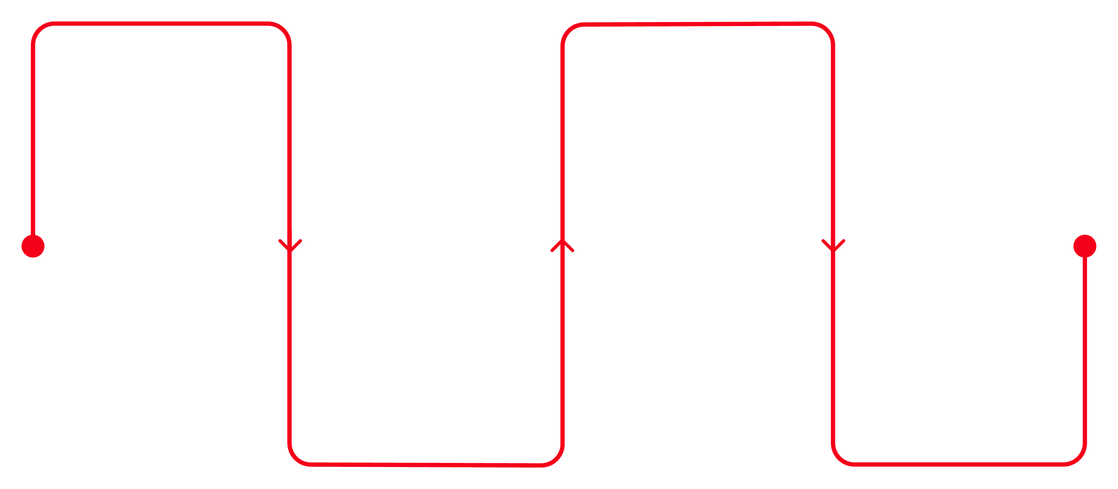
End-to-End Project Pipeline
Data Prep
Power BI
Load, clean, feature engineer in Python
Interactive Analysis and Detail pages
Recommendations
SQL Analysis
Subscriptions, loyalty, and marketing actions
Run 10 business queries in MySQL
A structured workflow from raw transactional data to actionable business insights, leveraging Python for data preparation, MySQL for structured analysis, and Power BI for interactive visualization.

Slide 10

Key Takeaways
3,900 Transactions
Analyzed across 18 features spanning demographics, purchase details, and shopping behavior
10 SQL Queries
Structured analysis covering revenue, segmentation, products, and subscriptions
Interactive Dashboard
Power BI Analysis and Detail pages for visual stakeholder presentation
5 Recommendations
Actionable strategies for subscriptions, loyalty, discounts, product positioning, and targeted marketing

